Slide 1
High-level Algorithm for Implementation of a complete Fuzzy System

Slide 2
Calculation of Degree of belonging of a crisp input to each of pre-defined fuzzy sets
Evaluation of degree of belonging g(x) for a crisp input x to a triangular fuzzy set defined by 3 parameters a, b, c (a < b < c)

Slide 3
Calculation of Degree of belonging of a crisp input to each of pre-defined fuzzy sets
Evaluation of degree of belonging g(x) for a crisp input x to a trapezoidal fuzzy set defined by 4 parameters a, b, c & d (a ≤ b < c ≤ d)

Slide 4
Typical form of Fuzzy Rules
IF x₁ ∈ A_{1,k1} AND x₂ ∈ A_{2,k2} AND …. x_{i} ∈ A_{i,ki} …. AND x_{n} ∈ A_{n,kn} THEN y ∈ B_{k}
where x_{i,} i = 1, 2, .., n, are the crisp inputs and
A_{i,ki} is the ki^{th} fuzzy set of the superset of fuzzy sets spanning the normalized range of input variable x_{i},
and y is the output, whose normalized space is spanned by sets B_{k}.
One may express diagrammatically:
Fuzzy Rule Base
and
Approximate Reasoning
x₁
Complete Fuzzy System
x₂
.
.
.
y
x_{n}

Slide 5
Firing Intensity of a Rule in the FAM
With reference to a 2-input and 1-output Fuzzy System:
If x₁ and x₂ are two crisp input variables and A_{1,k1} and A_{2,k2} are two corresponding fuzzy sets activated by these inputs and their degrees of activation are given by μ₁(A_{1,k1}(x₁)) and μ₂(A_{2,k2}(x₂)),
then
the Firing Intensity of the rule B_{k} of the fuzzified output variable, given by μ_{k}(B_{k}(x₁,x₂)), is:
k is the single running variable across all rules in the FAM.
In a 2D FAM if the row variable index is k1 = 1, 2, …,m; and the column variable index is k2 = 1, 2, ….,n, then k can be expressed as a function of k1 and k2 as:

Slide 6
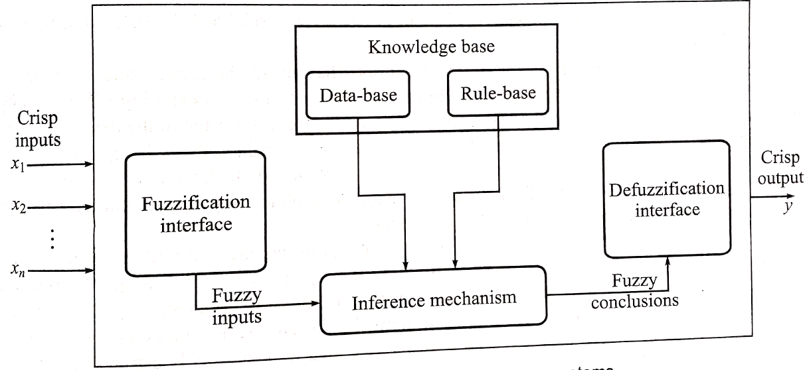
Complete Fuzzy System

Slide 7
Algorithm
Step 1: Get the number of input variables for your system as well as the range of each input variable and the output variable
Step 2: Normalize each variable between -1 to +1 linearly (ideally) using where x_{i} and X_{i} are the original and normalized variables for variable i, and u_{i} and l_{i} are corresponding upper and lower bounds
Step 3: Decide on the number of fuzzy sets that you will use to granulate each input as well as the output
Step 4: Decide on the type and distribution of fuzzy sets for each input and output variable, i.e. centroid and span (boundaries)
Step 5: Formulate the Fuzzy Associative Matrix (FAM : also called Fuzzy Inference Engine)

Slide 8
Algorithm (cont’d)
Step 6: Given a crisp input vector (numbers), first, fuzzify all variables; i.e. decide on degree of belonging of each var to each fuzzy set spanning the range of that var (number of sub-steps)
Step 7: Calculate the degree of activation of each cell of the FAM by the product rule (number of sub-steps)
Step 8: Defuzzify to obtain the crisp output:
where w_{k} is the weight, i.e. degree of activation, of cell k where k is the single running variable over all cells
k ∈ {1, 2, ..N}; ; m_{i} is granulation level of input variable i
C_{k} is the centroid of cell k.

Slide 9
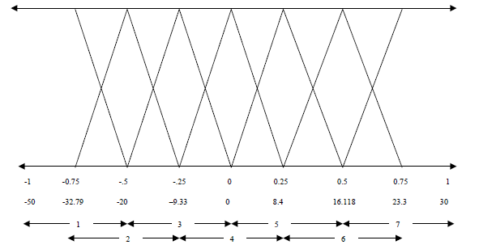
Typical Fuzzy Set (MF) Distributions (seven symmetric fuzzy sets)

Slide 10
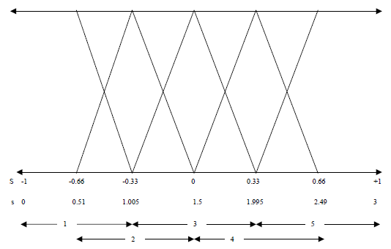
Typical Fuzzy Set (MF) Distributions (five symmetric fuzzy sets)

Slide 11
Working Example Follows

Slide 12
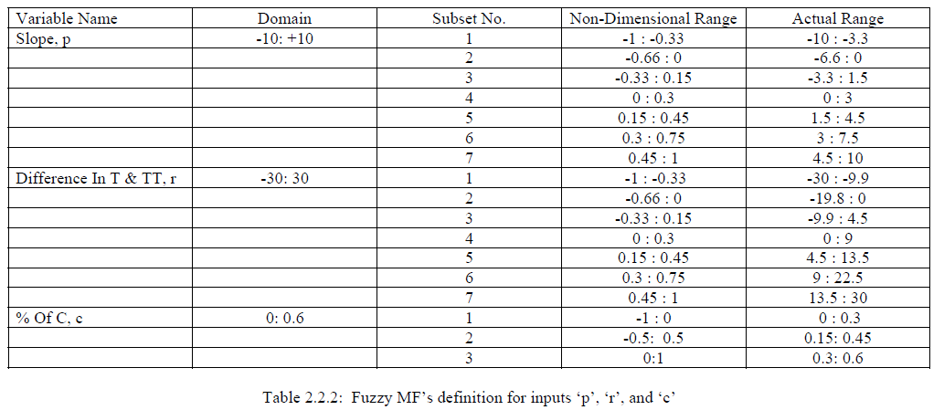
Documentation of input fuzzification

Slide 13
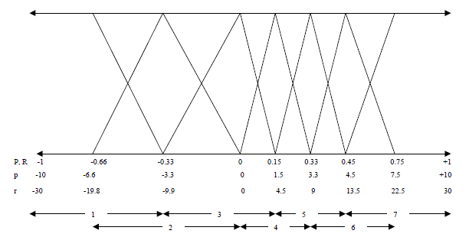
Typical Fuzzy Set (MF) Distributions: Finer in regions where sensitivity of output to input is higher

Slide 14
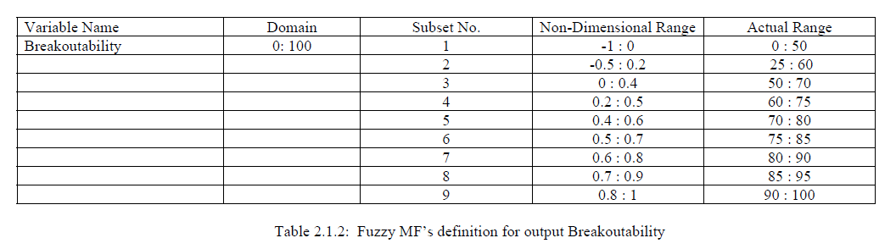
Documentation of output fuzzification

Slide 15
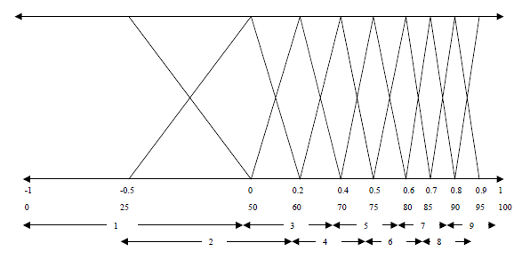
Typical Fuzzy Set (MF) Distributions (Output)

Slide 16
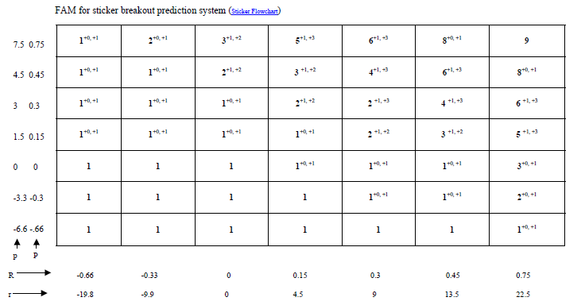
FAM for a 3-input system: 2 primary, 1 secondary (next slide explains how a 2-D FAM accommodates the 3rd input var)

Slide 17
Explanation of how a 2-D FAM accommodates the 3rd input var
The third input var is composed of only 3 fuzzy sets
The base values in the FAM (previous slide) denote the value of the output fuzzy set activated when the 3rd var is in its first fuzzy set
The two indices with a plus are not strictly indices, they are the value by which the base value is to be incremented to provide the activated output fuzzy set when the 3rd var is in its 2nd or 3rd fuzzy set
You may notice that the total never adds up to more than 9, the total number of output fuzzy sets.

